Slide 1
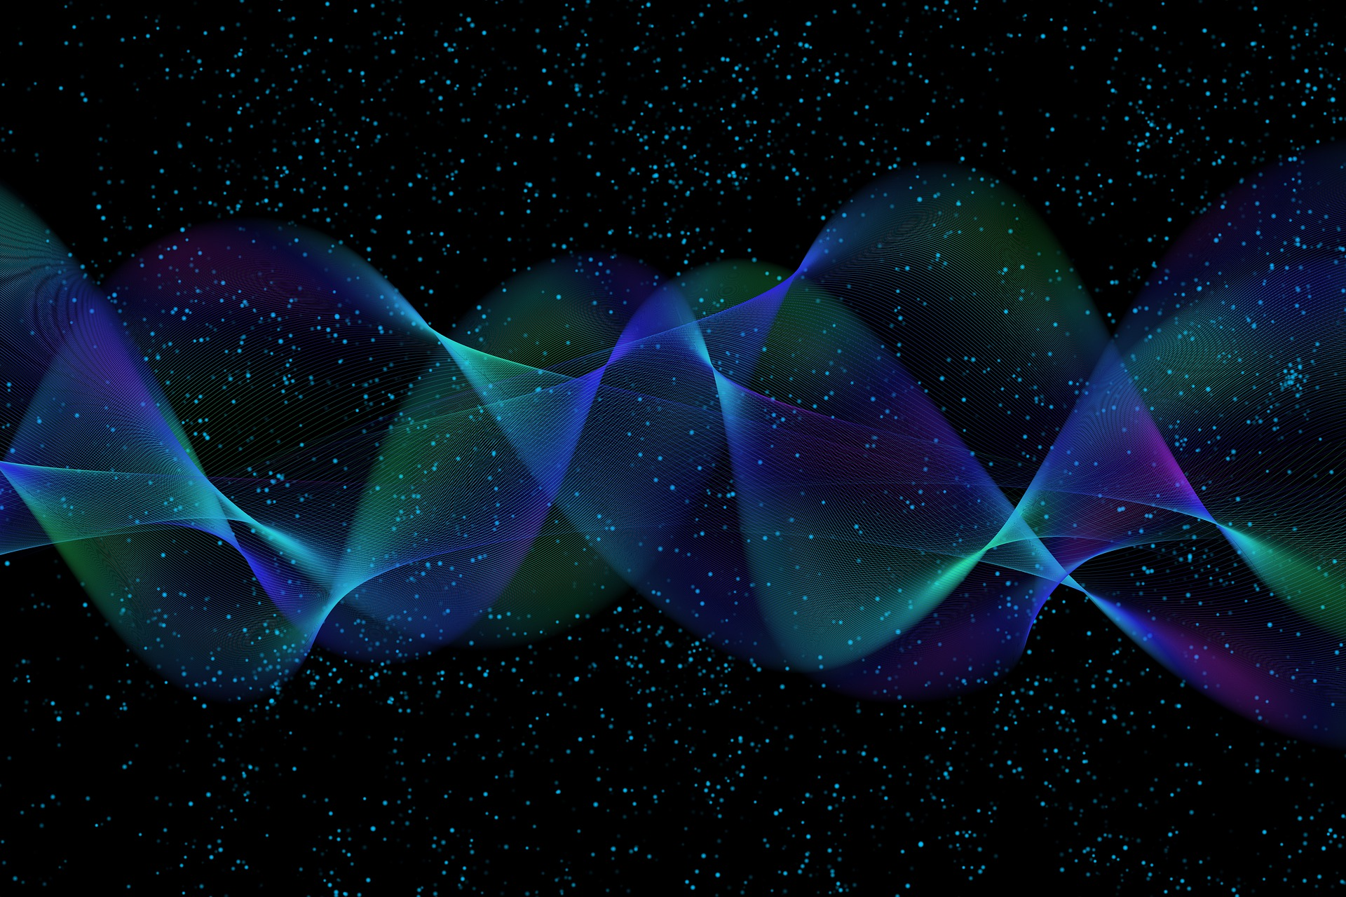
Quantum Computing
6. Quantum Communications
Quantum Computing Insitute
https://qcict.org
Prof. Aleksandar Radovanovic
alex@qcict.org

Slide 2
Conjugate Coding (1968)
Stephen Wiesner (1942-2021)
Wiesner’s original illustration of conjugate coding.
Reference:
Stephen Wiesner. 1983. Conjugate coding. SIGACT News 15, 1 (Winter-Spring 1983), 78–88.
Notes:
The history of quantum communication and cryptography goes back to 1968, when Stephen Wiesner wrote his famous but then-overlooked manuscript, “Conjugate Coding.” In it, he proposed using the polarization of light to encode and transmit information in quantum states. The key idea of conjugate coding was that information could be encoded using different, incompatible polarization bases.
The word conjugate means paired or related. In conjugate coding, it refers to two different quantum bases that are related but incompatible for measurement.
Wiesner’s work was so far ahead of its time that it was initially rejected and remained unpublished for more than 15 years. Today, however, Wiesner is widely recognized as one of the founding figures of quantum cryptography.
Reference
Stephen Wiesner. 1983. Conjugate coding. SIGACT News 15, 1 (Winter-Spring 1983), 78–88. https://doi.org/10.1145/1008908.1008920

Slide 3
Photon Polarization in Quantum Communication
Unpolarized light
Polarizer
Polarized single photons
vertical axis
photon
In ordinary light, the electric field oscillates in many random directions in the plane perpendicular to the direction of travel.
A polarization filter (polarizer) transmit only the component of the electric field that is aligned with its axis.
After the polarizer, photons are in well-defined polarization state: their electric field oscillates in a single plain (here: vertical)
Electric field E
Possible direction of E
Notes:
In general, quantum communication relies on elementary particles of light, called photons, as carriers of information. For quantum communication, individual polarized photons can be used as qubits. Polarization refers to the orientation of the photon's electric field.
Photons are not only particles of light but also have wave-like properties. Light consists of electric and magnetic fields that oscillate in directions perpendicular to each other. In ordinary, unpolarized light, the electric field can oscillate in many different directions. When light passes through a polarization filter, only a particular polarization is transmitted. Different polarization directions can therefore be used to represent and encode quantum information, where polarization refers to the orientation of the photon’s electric field.

Slide 4
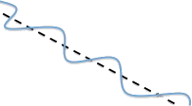
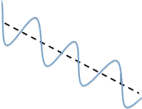
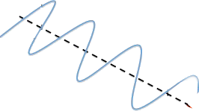
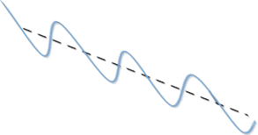


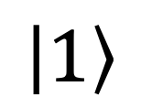
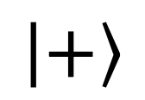
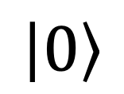
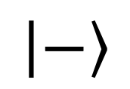
Qubit Encoding with Photons
$$\left|0\right\rangle$$
$$\left|1\right\rangle$$
$$\left|+\right\rangle$$
$$\left|−\right\rangle$$
horizontal
vertical
+ diagonal
– diagonal
standard basis {|0⟩, |1⟩}
diagonal basis: {|+⟩, |–⟩}
Notes:
Data are encoded and transmitted using polarized photons as qubits.
A horizontally polarized photon encodes the qubit |0⟩.
A vertically polarized photon encodes the qubit |1⟩.
A diagonally polarized photon at 45° encodes the qubit |+⟩.
A diagonally polarized photon at 135° encodes the qubit |−⟩.
The states |0⟩ and |1⟩ form the standard (Z) basis, while |+⟩ and |−⟩ form the diagonal (X) basis.

Slide 5
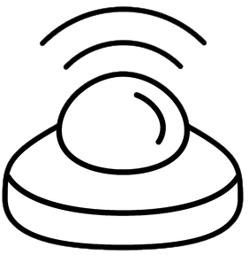


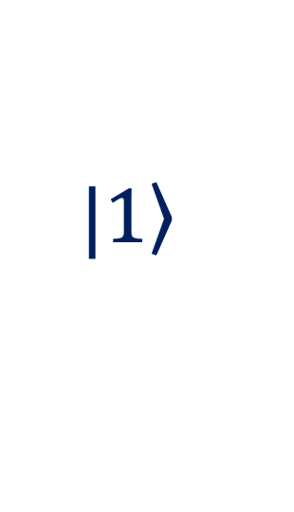
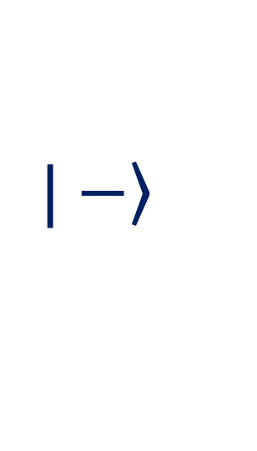
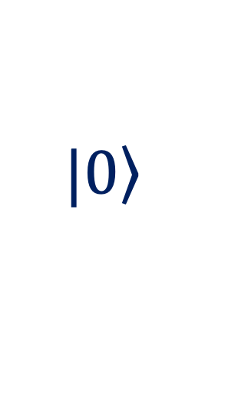
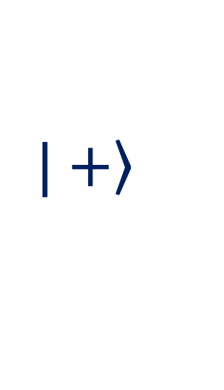




Wiesner’s Conjugate Coding
$$\left.|0\right\rangle$$
$$0$$
$$1$$
0,1,0…
0100101010001100010100100111111010010100000
$$\left.|1\right\rangle$$
$$\left.|+\right\rangle$$
$$0$$
$$1$$
0,1,0…
$$\left.|−\right\rangle$$
Notes:
Wiesner proposed encoding classical bits into individual photons, with each photon prepared in one of four possible polarization states, chosen from two mutually unbiased bases.
For example, before sending a message to Bob, Alice chooses one of the two bases and uses a polarization filter to encode her bits into photonic qubits.
If she chooses the standard basis, Alice encodes the bits using horizontal and vertical polarizations, corresponding to the qubit states {∣0⟩,∣1⟩}.
If she chooses the diagonal (conjugate) basis, she uses polarizations at +45° and −45°, corresponding to the qubit states {∣+⟩,∣−⟩}.
Bob can reliably decode each bit if he measures the photon using the same basis that Alice used for encoding. If he uses the other basis, his measurement result is random.

Slide 6




The Role of Measurement Bases
0_{(50%)}
0_{(50%)}
0
1
1_{(50%)}
1_{(50%)}
$$\left|0\right\rangle$$
$$\left|+\right\rangle$$
$$\left|−\right\rangle$$
$$\left|1\right\rangle$$
standard basis measurement
Notes:
In the standard basis measurement:
If a horizontally polarized photon reaches the detector, it is detected as 0.
If a vertically polarized photon reaches the detector, it is detected as 1..
However, if a +45° diagonally polarized photon reaches the detector, it is detected as 0 or 1, each with a 50% probability. This is because ∣+⟩ is a superposition of ∣0⟩ and ∣1⟩, and when measured, the superposition collapses to one of these states..
The same applies to a −45° diagonally polarized photon.

Slide 7




The Role of Measurement Bases
0_{(50%)}
0_{(50%)}
0
1
1_{(50%)}
1_{(50%)}
$$\left|0\right\rangle$$
$$\left|+\right\rangle$$
$$\left|−\right\rangle$$
$$\left|1\right\rangle$$
diagonal basis measurement
Notes:
If the detector is rotated by 45° the measurement is performed in the diagonal basis.
A photon in the state ∣+⟩ will be detected as 0.
A photon in the state ∣−⟩ will be detected as 1.
Since ∣0⟩ can be expressed as a superposition of ∣+⟩ and ∣−⟩, measuring it in the diagonal basis produces a random result: 0 or 1, each with a 50% probability.
The same applies to ∣1⟩.
In general, if the measurement basis matches the encoding basis, the encoded bit is correctly detected. However, if the bases do not match, the measurement produces a random bit. These simple rules form the foundation of quantum communication and cryptographic protocols.

Slide 8
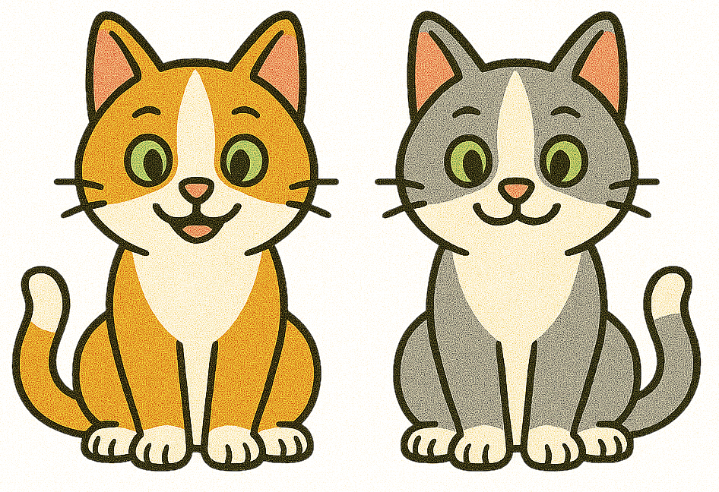


Quantum entanglement
Notes:
Quantum entanglement plays an important role not only in quantum communication and cryptography, but also in quantum computing in general.
Quantum entanglement occurs when two or more qubits share a single combined quantum state that cannot be described independently. The qubits become strongly correlated, so measuring one provides information about the other, even when they are far apart.

Slide 9
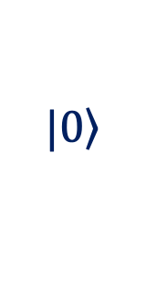
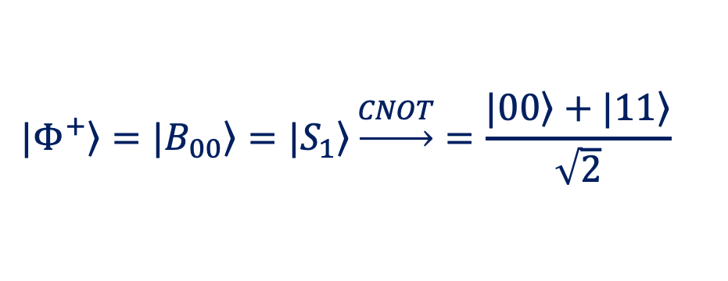
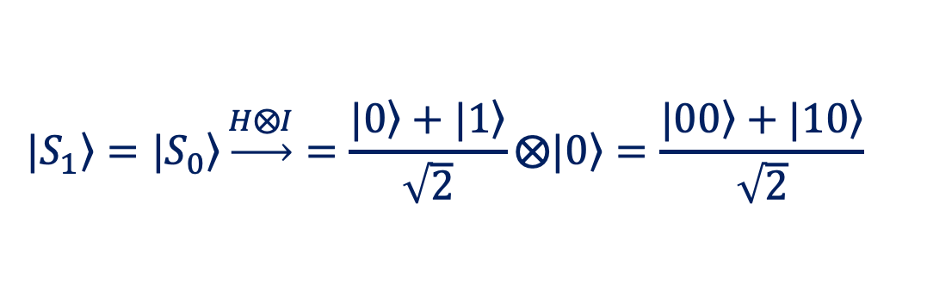
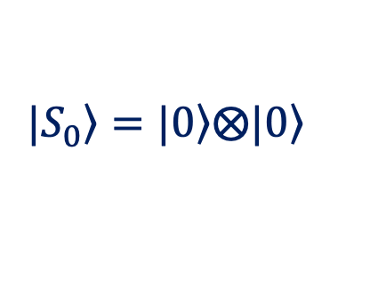

Creating a Bell State
$$\left.|0\right\rangle$$
H
$$\left.|0\right\rangle$$
+
$$\left.|S_{0}\right\rangle =\left.|0\right\rangle \left.⨂|0\right\rangle$$
John Bell (1928 – 1990)
$$\left.|S_{1}\right\rangle =\left.|S_{0}\right\rangle \underset{→}{H⨂I}=\frac{\left.|0\right\rangle +\left.|1\right\rangle }{\sqrt{2}}\left.⨂|0\right\rangle =\frac{\left.|00\right\rangle +\left.|10\right\rangle }{\sqrt{2}}$$
$$\left.|Φ^{+}\right\rangle =\left.|B_{00}\right\rangle =\left.|S_{1}\right\rangle \underset{→}{CNOT}=\frac{\left.|00\right\rangle +\left.|11\right\rangle }{\sqrt{2}}$$
Notes:
To create a two-qubit entangled state, start with two qubits initialized to the state ∣00⟩.
Next, applying the Hadamard gate to the first qubit puts it into superposition, while the second qubit remains in the state ∣0⟩ ∣0⟩:
$$\frac{\left.|0\right\rangle +\left.|1\right\rangle }{\sqrt{2}}\left.⨂|0\right\rangle$$
Finally, the CNOT gate flips the second (target) qubit when the first (control) qubit is ∣1⟩. Therefore, only the target qubit in the second component of the superposition is flipped:
$$\frac{\left.|00\right\rangle +\left.|11\right\rangle }{\sqrt{2}}$$
This creates the Bell state denoted by $\left.|Φ^{+}\right\rangle$ or $\left.|B_{00}\right\rangle$.
The Bell states are named after physicist John Bell, whose pioneering work on quantum entanglement was carried out long before quantum computers were developed.

Slide 10
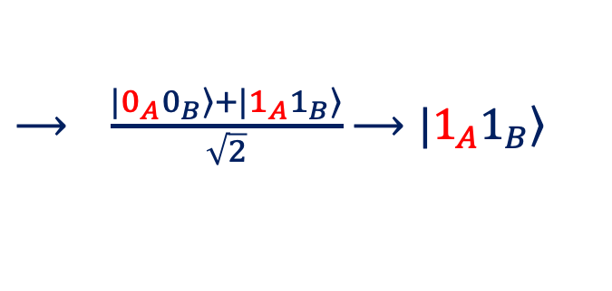
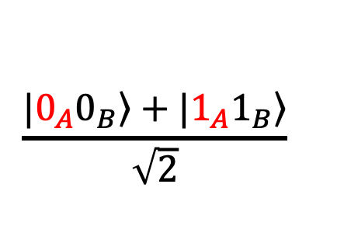




What is special about the Bell state?
$$1$$
$$\left.|0\right\rangle$$
H
$$\frac{\left.|0_{A}0_{B}\right\rangle +\left.|1_{A}1_{B}\right\rangle }{\sqrt{2}}$$
$⟶ \frac{\left.|0_{A}0_{B}\right\rangle +\left.|1_{A}1_{B}\right\rangle }{\sqrt{2}}$ $\left.⟶|1_{A}1_{B}\right\rangle$
$$\left.|0\right\rangle$$
+
$$1$$
Notes:
What is special about the Bell state?
Let’s say that Alice and Bob share an entangled pair. The first qubit belongs to Alice and the second to Bob. The two qubits share the Bell state
$$\left.|Φ^{+}\right\rangle =\frac{\left.|00\right\rangle +\left.|11\right\rangle }{\sqrt{2}}$$
The pair is therefore in a superposition of the two possibilities ∣00⟩ and ∣11⟩.
Next, Alice measures her qubit and obtains the result 1. The shared state then collapses to ∣11⟩, consistent with her measurement result.
When Bob measures his qubit in the same basis, he will also obtain 1. In other words, their measurement results are perfectly correlated.

Slide 11

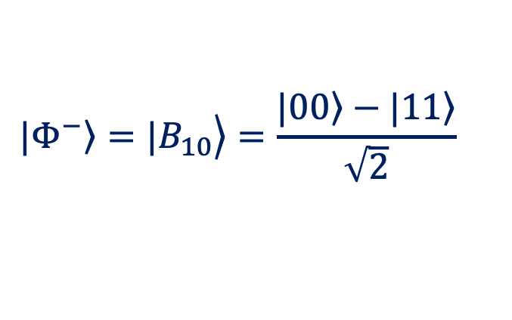
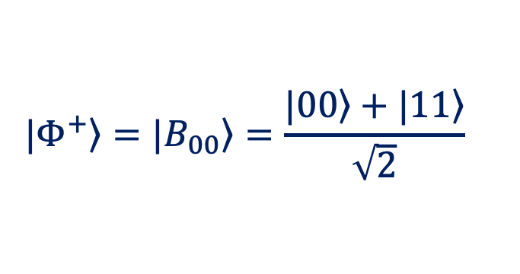
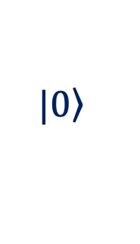





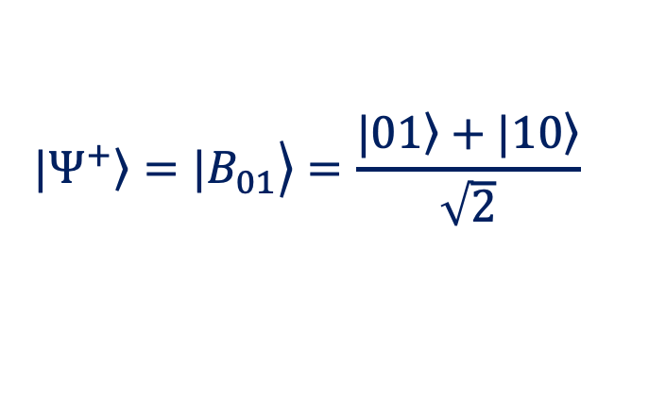
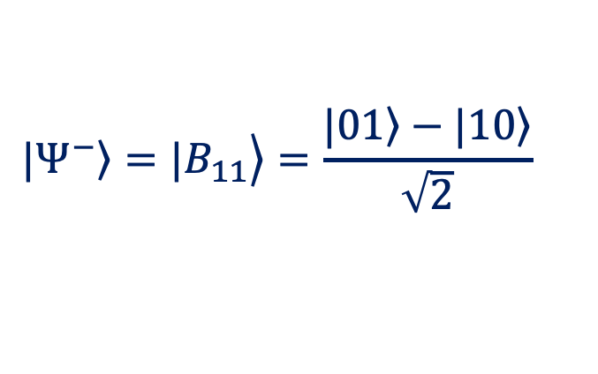

Generating Bell States
$$\left.|0\right\rangle$$
$$\left.|0\right\rangle$$
H
H
$$\left.|0\right\rangle$$
$$\left.|0\right\rangle$$
+
+
+
$$\left.|Φ^{+}\right\rangle =\left.|B_{00}\right\rangle =\frac{\left.|00\right\rangle +\left.|11\right\rangle }{\sqrt{2}}$$
$$\left.\left.|Ψ^{+}\right\rangle =|B_{01}\right\rangle =\frac{\left.|01\right\rangle +\left.|10\right\rangle }{\sqrt{2}}$$
$$\left.|0\right\rangle$$
$$\left.|0\right\rangle$$
+
H
+
H
$$\left.|0\right\rangle$$
$$\left.|0\right\rangle$$
+
+
+
$$\left.\left.|Φ^{−}\right\rangle =|B_{10}\right\rangle =\frac{\left.|00\right\rangle −\left.|11\right\rangle }{\sqrt{2}}$$
$$\left.\left.|Ψ^{−}\right\rangle =|B_{11}\right\rangle =\frac{\left.|01\right\rangle −\left.|10\right\rangle }{\sqrt{2}}$$
Notes:
There are exactly four maximally entangled Bells states.
The first Bell state is traditionally denoted by physicists as $\left.|Φ^{+}\right\rangle$. In quantum computing, it can also be labeled $\left.|B_{00}\right\rangle$​. This state is generated by the Bell-state preparation circuit shown in the figure, starting from the input state $\left.|00\right\rangle .$
Starting from $\left.|10\right\rangle$, the same circuit produces $\left.|B_{10}\right\rangle$, or $\left.|Φ^{−}\right\rangle$.
Similarly, starting from $\left.|01\right\rangle$, the circuit produces$\left.|B_{01}\right\rangle$,​ or $\left.|Ψ^{+}\right\rangle$.
Finally, starting with $\left.|11\right\rangle$, the circuit produces$\left.|B_{11}\right\rangle$​​, or $\left.|Ψ^{−}\right\rangle$.
The four Bell states form an orthonormal basis for the two-qubit state space, known as the Bell basis, and are widely used in quantum computing and quantum communication.

Slide 12

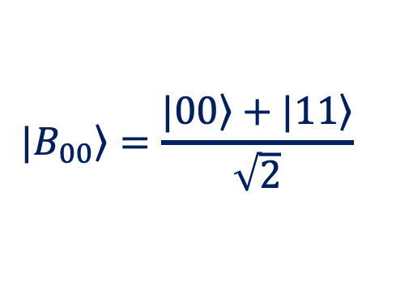
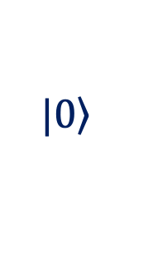
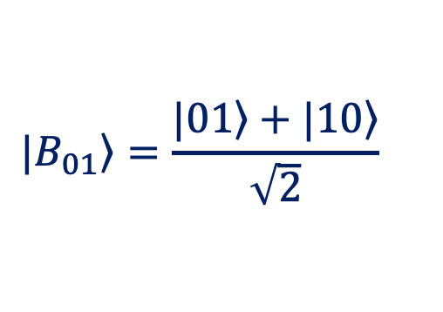
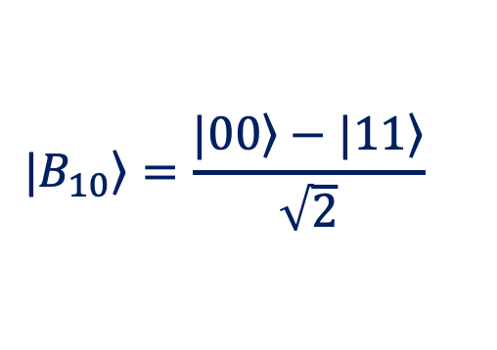


Transforming Bell States
$$\left.|0\right\rangle$$
$$\left.|0\right\rangle$$
H
H
+
$$\left.|B_{00}\right\rangle =\frac{\left.|00\right\rangle +\left.|11\right\rangle }{\sqrt{2}}$$
$$\left.|B_{01}\right\rangle =\frac{\left.|01\right\rangle +\left.|10\right\rangle }{\sqrt{2}}$$
$$\left.|0\right\rangle$$
$$\left.|0\right\rangle$$
+
+
$$\left.|0\right\rangle$$
$$\left.|0\right\rangle$$
H
Z
H
+
Z
$$\left.|B_{10}\right\rangle =\frac{\left.|00\right\rangle −\left.|11\right\rangle }{\sqrt{2}}$$
$$\left.|B_{11}\right\rangle =\frac{\left.|01\right\rangle −\left.|10\right\rangle }{\sqrt{2}}$$
$$\left.|0\right\rangle$$
$$\left.|0\right\rangle$$
+
+
Notes:
In quantum communications, we can imagine a source that generates basic Bell pairs in the state |B₀₀⟩ and distributes them to users. A user can then apply a local operation to their qubit to transform the basic Bell state into any of the other three Bell states.
By applying an X gate to the first qubit of the Bell pair, the value of that qubit is inverted, producing the state |B₀₁⟩ at the output.
By applying a Z gate to the first qubit of the Bell pair, the sign of the |11⟩ term is changed, corresponding to a change in relative phase, and the state |B₁₀⟩ is obtained at the output.
By applying an X-Z sequence, both the value of the first qubit and the relative phase are changed, producing the state |B₁₁⟩ at the output.

Slide 13

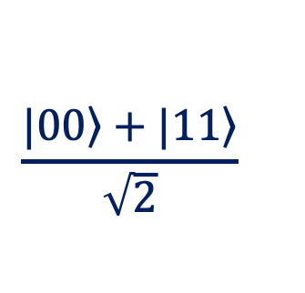
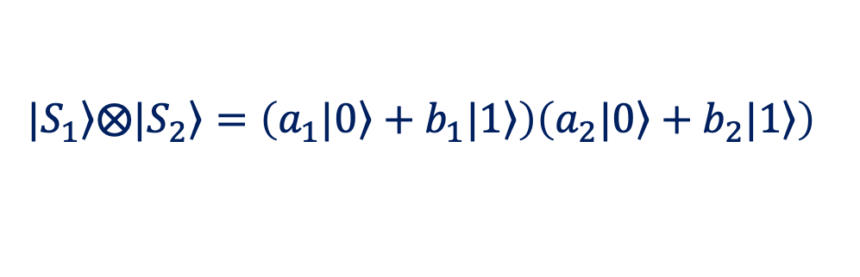

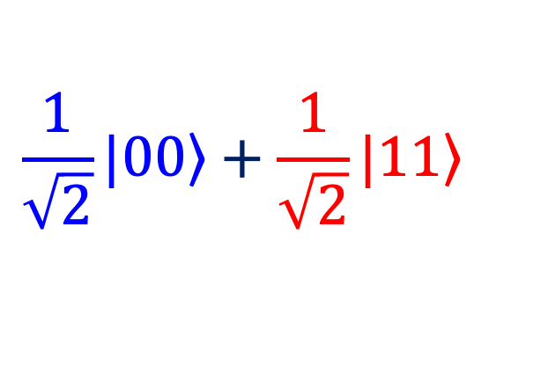
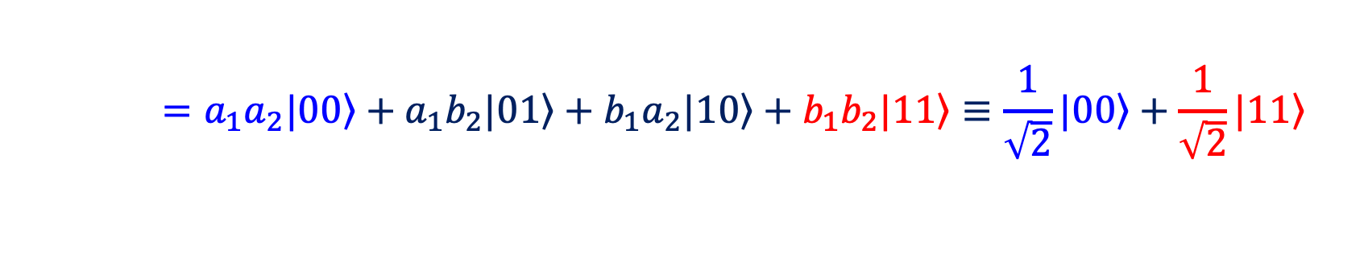

Properties of Quantum Entanglement
Entangled state:
$$\frac{\left.|00\right\rangle +\left.|11\right\rangle }{\sqrt{2}}$$
1) Entanglement cannot be separated (inseparability):
$$\left.|S_{1}\right\rangle ⨂\left.|S_{2}\right\rangle =\left(\left.a_{1}|0\right\rangle +\left.b_{1}|1\right\rangle \right)\left(\left.a_{2}|0\right\rangle +\left.b_{2}|1\right\rangle \right)$$
$$\left.{ =a}_{1}a_{2}|00\right\rangle +\left.a_{1}b_{2}|01\right\rangle +\left.b_{1}a_{2}|10\right\rangle +\left.b_{1}b_{2}|11\right\rangle ≡\frac{1}{\sqrt{2}}\left.|00\right\rangle +\frac{1}{\sqrt{2}}\left.|11\right\rangle$$
${ a}_{1}a_{2}=b_{1}b_{2}=1/\sqrt{2}$ and $a_{1}b_{2}=b_{1}a_{2}=0$
2) Measurement correlation:
$$\frac{1}{\sqrt{2}}\left.|00\right\rangle +\frac{1}{\sqrt{2}}\left.|11\right\rangle$$
$$0$$
Notes:
Quantum entanglement has two important properties: inseparability and measurement correlation. Consider the entangled Bell state
$$\frac{\left.|00\right\rangle +\left.|11\right\rangle }{\sqrt{2}}$$
Inseparability means that an entangled state cannot be written as the Kronecker product of two independent qubit states. Suppose
$$\left.|S_{1}\right\rangle =\left.a_{1}|0\right\rangle +\left.b_{1}|1\right\rangle , \left.|S_{2}\right\rangle =\left.a_{2}|0\right\rangle +\left.b_{2}|1\right\rangle$$
then $\left.|S_{1}\right\rangle ⨂\left.|S_{2}\right\rangle \left.{=a}_{1}a_{2}|00\right\rangle +\left.a_{1}b_{2}|01\right\rangle +\left.b_{1}a_{2}|10\right\rangle +\left.b_{1}b_{2}|11\right\rangle$
To reproduce the Bell state, we would need ${ a}_{1}a_{2}=b_{1}b_{2}=1/\sqrt{2}$ and $a_{1}b_{2}=b_{1} a_{2}=0$
These conditions cannot be satisfied simultaneously. Therefore, the Bell state cannot be separated into two independent qubit states.
Measurement correlation means that the measurement outcomes are perfectly correlated. If the first qubit is measured as 0, the state becomes ∣00⟩, so the second qubit is also 0. If the first is measured as 1, the state becomes ∣11⟩, so the second qubit is also 1.

Slide 14
Bell-State Measurement Correlations
$$\left.|Φ^{+}\right\rangle =\left.|B_{00}\right\rangle =\frac{\left.|00\right\rangle +\left.|11\right\rangle }{\sqrt{2}}$$
00
11
$$\left.\left.|Φ^{−}\right\rangle =|B_{10}\right\rangle =\frac{\left.|00\right\rangle −\left.|11\right\rangle }{\sqrt{2}}$$
00
11
$$\left.\left.|Ψ^{+}\right\rangle =|B_{01}\right\rangle =\frac{\left.|01\right\rangle +\left.|10\right\rangle }{\sqrt{2}}$$
01
10
$$\left.\left.|Ψ^{−}\right\rangle =|B_{11}\right\rangle =\frac{\left.|01\right\rangle −\left.|10\right\rangle }{\sqrt{2}}$$
01
10
Notes:
When we measure the Bell state $\left.|B_{00}\right\rangle$, the results are always correlated: we obtain either 00 or 11, each with 50% probability..
The same is true for the Bell state $\left.|B_{10}\right\rangle$. The minus sign represents a relative phase, but it does not affect measurement probabilities in the standard basis. We again obtain either 00 or 11.
In contrast, measuring $\left.|B_{01}\right\rangle$ produces anti-correlated results: we obtain either 01 or 10, each with 50% probability.
The same is true for $\left.|B_{11}\right\rangle$.
These correlations make Bell states useful in quantum communication and cryptography. If two parties share a Bell pair, measuring their qubits produces either the same or opposite results, depending on the Bell state they share.

Slide 15
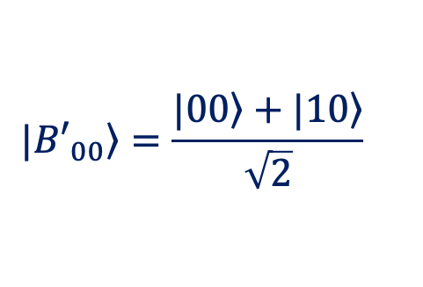
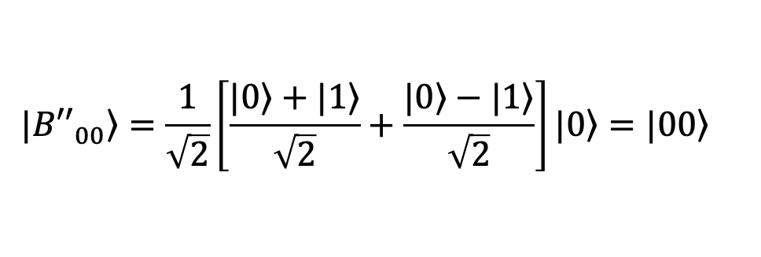
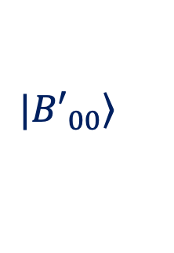
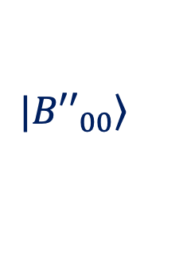
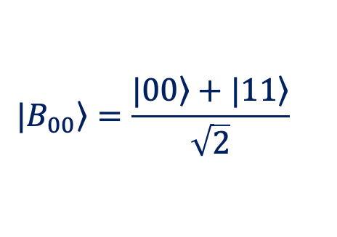

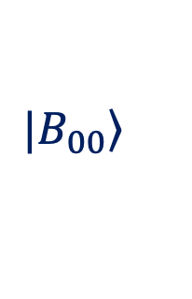


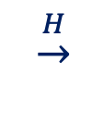
Decoding Bell States
$$\left.|0\right\rangle$$
H
$$\left.|0\right\rangle$$
H
$$\left.|B_{00}\right\rangle$$
$$\left.|{B′}_{00}\right\rangle$$
$$\left.|{B′′}_{00}\right\rangle$$
$$\left.|0\right\rangle$$
+
+
$$\left.|0\right\rangle$$
$$\left.|B_{00}\right\rangle =\frac{\left.|00\right\rangle +\left.|11\right\rangle }{\sqrt{2}}$$
$$\left.|{B′}_{00}\right\rangle =\frac{\left.|00\right\rangle +\left.|10\right\rangle }{\sqrt{2}}$$
$$\left.|{B′′}_{00}\right\rangle =\frac{1}{\sqrt{2}}\left[\frac{\left.|0\right\rangle +\left.|1\right\rangle }{\sqrt{2}}+\frac{\left.|0\right\rangle −\left.|1\right\rangle }{\sqrt{2}}\right]\left.|0\right\rangle =\left.|00\right\rangle$$
$$\underset{→}{CX}$$
$$\underset{→}{H}$$
Notes:
In some applications, it is necessary to decode a Bell state, transforming the entangled qubits back into separate qubits. For example, consider decoding the Bell state $\left.|B_{00}\right\rangle$.
Since quantum gates are reversible, this can be done by applying the Bell-state preparation circuit in reverse order. First, the CX gate flips the second qubit whenever the first qubit is ∣1⟩:
$$\frac{\left.|00\right\rangle +\left.|11\right\rangle }{\sqrt{2}}\underset{→}{CX}\frac{\left.|00\right\rangle +\left.|10\right\rangle }{\sqrt{2}}$$
Next, applying the Hadamard gate introduces quantum interference. The amplitudes of the ∣1⟩ component interfere destructively and cancel, while the amplitudes of the ∣0⟩ component interfere constructively. As a result, the two qubits return to the state ∣00⟩.
After measuring both qubits, the result 00 identifies the original Bell state as $\left.|B_{00}\right\rangle$. Applying this inverse Bell circuit followed by measurement allows us to distinguish the four Bell states. This is called measurement in the Bell basis..

Slide 16

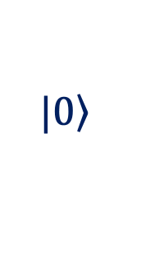
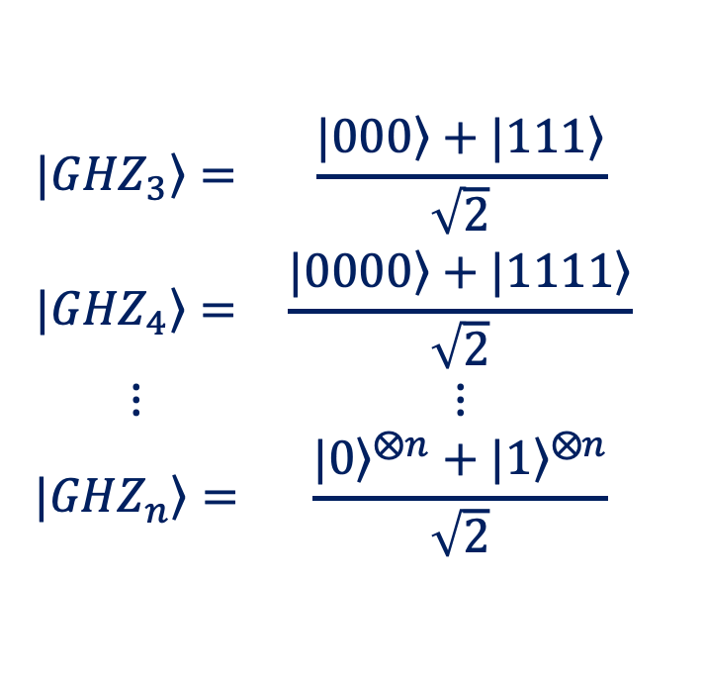
Entangling Multiple Qubits: GHZ States
$$\left.|0\right\rangle$$
H
GHZ state (Greenberger–Horne–Zeilinger)
$$\left.|0\right\rangle$$
+
$$\begin{matrix}\left.|{GHZ}_{3}\right\rangle = & \frac{\left.|000\right\rangle +\left.|111\right\rangle }{\sqrt{2}} \\ \left.|{GHZ}_{4}\right\rangle = & \frac{\left.|0000\right\rangle +\left.|1111\right\rangle }{\sqrt{2}} \\ ⋮ & ⋮ \\ \left.|{GHZ}_{n}\right\rangle = & \frac{{\left.|0\right\rangle }^{⨂n}+{\left.|1\right\rangle }^{⨂n}}{\sqrt{2}}\end{matrix}$$
$$\left.|0\right\rangle$$
+
$$\left.|0\right\rangle$$
$$\left.|0\right\rangle$$
+
Notes:
Three or more qubits can also be entangled. The circuit shown in the diagram builds upon the Bell-state circuit by adding an additional CNOT gate for each new qubit. This creates a GHZ state (Greenberger–Horne–Zeilinger state), named after the physicists who introduced it.
A GHZ state is a superposition of all qubits being in ∣0⟩ and all qubits being in ∣1⟩. For three qubits,
$$\left.|{GHZ}_{3}\right\rangle =\frac{\left.|000\right\rangle +\left.|111\right\rangle }{\sqrt{2}}$$
Qubits in a GHZ state show strong correlations, similar to those in a Bell pair. For a three-qubit GHZ state, if one qubit is measured as 1, the remaining two qubits collapse to ∣11⟩. If it is measured as 0, they collapse to ∣00⟩.

Slide 17
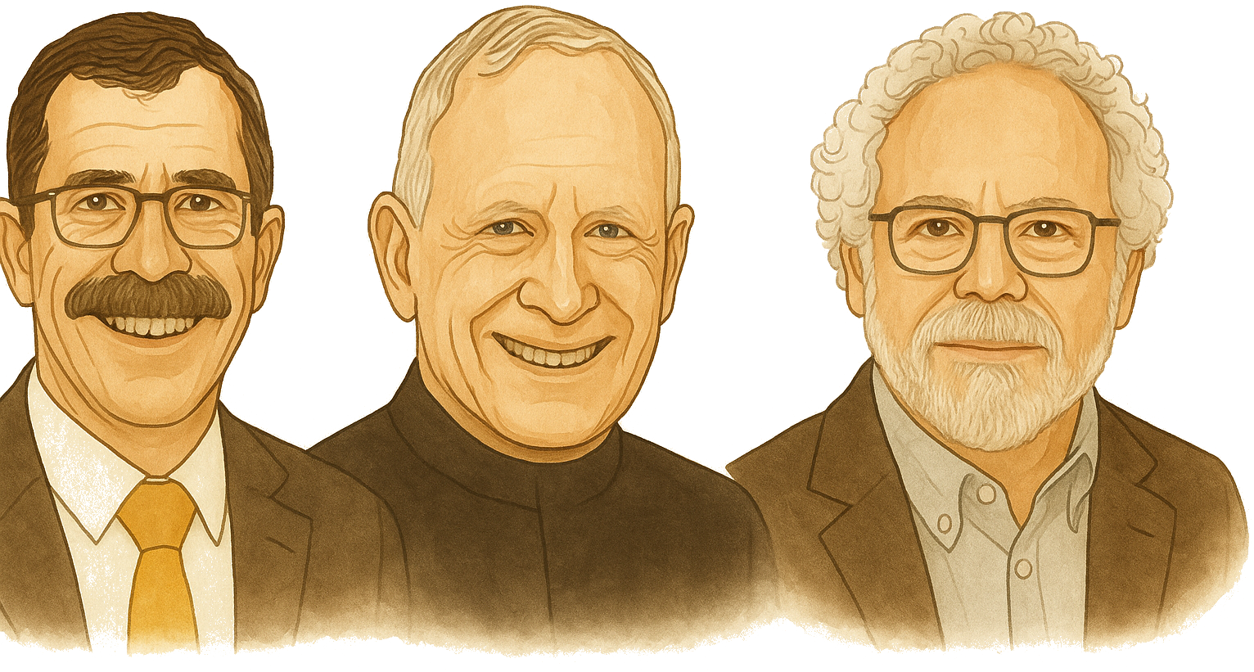
Nobel Prize 2022: Pioneers of Quantum Entanglement
Alain Aspect John Clauser Anton Zeilinger
Notes:
In 2022, Alain Aspect, John Clauser, and Anton Zeilinger were awarded the Nobel Prize in Physics for their ground breaking experiments with quantum entanglement.
Their work established the foundations for quantum information science, including quantum communication, quantum cryptography, and other modern quantum technologies.

Slide 18
EPR Paradox
Albert Einstein, Boris Podolsky, Nathan Rosen
Can Quantum-Mechanical Description of Physical Reality Be Considered Complete?
Physical Review (1935)
The New York Times, 4 May 1935
Notes:
It is interesting to note that in 1935, Albert Einstein, Boris Podolsky, and Nathan Rosen published a famous paper titled "Can Quantum-Mechanical Description of Physical Reality Be Considered Complete?” Even The New York Times covered the paper with the headline: "Einstein Attacks Quantum Theory.”
The paper, now known as the EPR paper, argued that the quantum-mechanical description of physical reality was incomplete. The abbreviation EPR comes from the initials of the authors’ last names: Einstein–Podolsky–Rosen.
The authors were particularly concerned with the strange correlations that quantum mechanics predicts between two separated particles. They argued that a measurement performed on one particle should not instantaneously affect the physical reality of another distant particle without any direct interaction between them.
The EPR paper became one of the most influential works in the foundations of quantum mechanics. It later inspired John Bell to formulate Bell’s theorem, which made it possible to experimentally test the predictions of quantum mechanics against local hidden-variable theories.
Because of this historical connection, a pair of maximally entangled qubits, such as a Bell pair, is also sometimes called an EPR pair, and Bell states are sometimes referred to as EPR states.

Slide 19

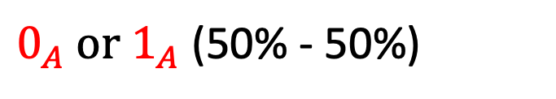
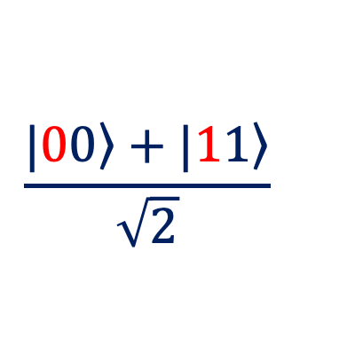
The No-communication Theorem
$$\frac{\left.|00\right\rangle +\left.|11\right\rangle }{\sqrt{2}}$$
$0_{A} or 1_{A}$ (50% - 50%)
$$0_{A}{→0}_{B} / 1_{A}→1_{B}$$
Quantum entanglement alone cannot be used to transmit information between two parties.
$$\left|0_{A}\right\rangle \frac{\left|0_{A}\right\rangle \left|0_{B}\right\rangle +\left|1_{A}\right\rangle \left|1_{B}\right\rangle }{\sqrt{2}}$$
Notes:
Because the two qubits in an entangled pair show an instant correlation, one might think that this could be used for faster-than-light communication. However, the no-communication theorem states that entanglement alone cannot be used to transmit information, because quantum measurement outcomes are random and cannot be controlled.
When Alice measures her qubit first, she randomly obtains either 0 or 1 and cannot choose the outcome. Bob’s measurement will be correlated with hers, but since Alice cannot control her outcome, she cannot use entanglement to send him a chosen bit.

Slide 20
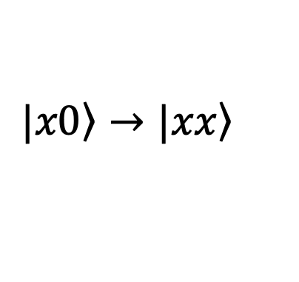
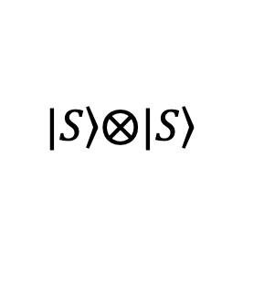
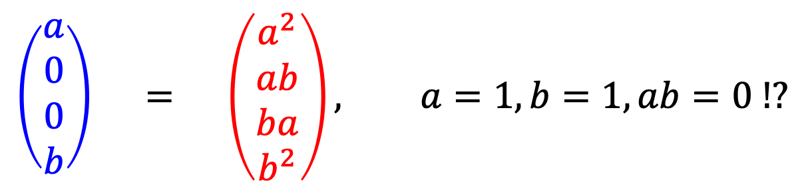
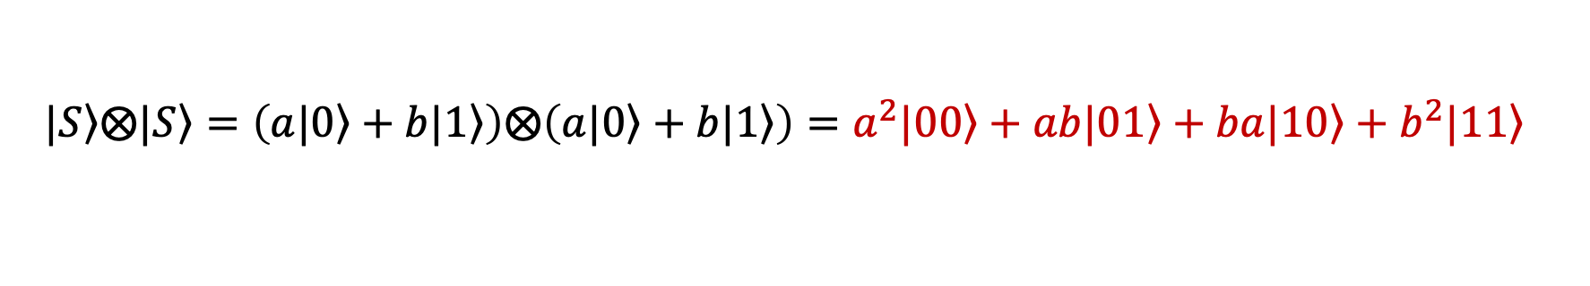


No-cloning Theorem
$$|\left.S\right\rangle$$
$$|\left.S\right\rangle$$
U_{c}
$$\left.|S\right\rangle \left.⨂|0\right\rangle =a\left.|00\right\rangle +b\left.|10\right\rangle$$
$$\left.|S\right\rangle \left.⨂|S\right\rangle$$
$$|\left.0\right\rangle$$
$$|\left.S\right\rangle$$
$$\left.|x0\right\rangle →\left.|xx\right\rangle$$
Output 1
$$U_{c}\left(a\left.|00\right\rangle +b\left.|10\right\rangle \right)={aU}_{c}\left.|00\right\rangle +{bU}_{c}\left.|10\right\rangle =a\left.|00\right\rangle +b\left.|11\right\rangle$$
Output 2
$$\left.|S\right\rangle ⨂\left.|S\right\rangle =\left(a\left.|0\right\rangle +b\left.|1\right\rangle \right)⨂\left(a\left.|0\right\rangle +b\left.|1\right\rangle \right)=a^{2}\left.|00\right\rangle +ab\left.|01\right\rangle +ba\left.|10\right\rangle +b^{2}\left.|11\right\rangle$$
Output 1
Output 2
$$\left(\begin{matrix}a \\ 0 \\ 0 \\ b\end{matrix}\right) = \left(\begin{matrix}a^{2} \\ ab \\ ba \\ b^{2}\end{matrix}\right), a=1,b=1, ab=0 !?$$
Notes:
Another theorem with important consequences for quantum communication is the no-cloning theorem. It states that an unknown quantum state cannot be perfectly copied. More precisely, there is no unitary operation that can create an identical copy of an arbitrary unknown quantum state.
This theorem is proved using a proof by contradiction.
Suppose that perfect cloning is possible and that there exists a cloning machine, represented by a linear operator $U_{c}$​, which takes as input a qubit in an unknown state $\left.|S\right\rangle$ and an ancillary qubit initialized to $\left.|0\right\rangle$.
The input to the machine is the state $\left.|S\right\rangle =a\left.|0\right\rangle +b\left.|1\right\rangle$, along with a blank slate $\left.|0\right\rangle$, which forms the two-qubit input state $\left.|S\right\rangle \left.⨂|0\right\rangle =a\left.|00\right\rangle +b\left.|10\right\rangle$. Each component of the superposition of the first qubit must be transferred to the second qubit at the output, meaning the transformation should follow the rule $\left.|x0\right\rangle →\left.|xx\right\rangle$. If this is the case, the expected output would be $a\left.|00\right\rangle +b\left.|11\right\rangle$.
On the other hand, if cloning is successful, the output should consist of two identical qubits in the state $\left.|S\right\rangle$, giving $\left.|S\right\rangle \left.⨂|S\right\rangle =a^{2}\left.|00\right\rangle +ab\left.|01\right\rangle +ba\left.|10\right\rangle +b^{2}\left.|11\right\rangle$. Comparing these two outputs, they are clearly not equal. For equality to hold, the coefficients must satisfy$a=1,b=1$and $ab=0$, which is a contradiction. Therefore, no linear transformation can perfectly clone an arbitrary qubit in an unknown superposition state..
Special Cases and Implications
It is important to note that the theorem allows for the copying of basis states $\left.|0\right\rangle$ and $\left.|1\right\rangle$. As seen earlier, copying basis states is possible using the controlled-X (CNOT) gate, where the control qubit (the one being copied) and the target qubit (initialized to $\left.|0\right\rangle$) undergo a conditional transformation.
However, if the superposition state is known, instead of cloning, we can prepare another qubit in the same state by applying the appropriate quantum gates. This process is distinct from cloning.
The no-cloning theorem has significant implications. On one hand, it explains why quantum memories are still not feasible. On the other hand, this fundamental property of quantum systems is advantageous in quantum cryptography, ensuring the security of quantum communication.

Slide 21










No-deleting Theorem
$$|\left.S\right\rangle$$
$$|\left.S\right\rangle$$
U_{d}
$$\left.|S\right\rangle \left.⨂|S\right\rangle$$
$$\left.|S\right\rangle \left.⨂|0\right\rangle =a\left.|00\right\rangle +b\left.|10\right\rangle$$
$$|\left.S\right\rangle$$
$$|\left.0\right\rangle$$
$$\left.|xy\right\rangle →\left.|x0\right\rangle$$
Output 1
$$U_{d}\left(a^{2}\left.|00\right\rangle +ab\left.|01\right\rangle +ba\left.|10\right\rangle +b^{2}\left.|11\right\rangle \right)=a^{2}\left.|00\right\rangle +ab\left.|00\right\rangle +ba\left.|10\right\rangle +b^{2}\left.|10\right\rangle$$
Output 2
$$\left.|S\right\rangle ⨂\left.|0\right\rangle =a\left.|00\right\rangle +b\left.|10\right\rangle$$
Output 1
Output 2
$$\left(\begin{matrix}a^{2}+ab \\ 0 \\ b^{2}+ab \\ 0\end{matrix}\right) = \left(\begin{matrix}a \\ 0 \\ b \\ 0\end{matrix}\right), a=1,b=0;a=0,b=0 !?$$
Notes:
A related result is the no-deleting theorem, which states that if two qubits are in identical unknown quantum states, it is impossible to delete the state of one qubit while leaving the other unchanged using a unitary operation.
This theorem is also proved using a proof by contradiction.
Suppose that deletion is possible and that there exists a deletion machine, represented by a linear operator $U_{d}$, which acts on two identical qubits in the state $\left.|S\right\rangle$. The joint state of the two qubits is: ${\left.|S\right\rangle \left.⨂|S\right\rangle =a}^{2}\left.|00\right\rangle +ab\left.|01\right\rangle +ba\left.|10\right\rangle +b^{2}\left.|11\right\rangle$. Each component of the superposition must be modified so that the second qubit is set to $\left.|0\right\rangle$, meaning the transformation should follow the rule $\left.|xy\right\rangle →\left.|x0\right\rangle$. If deletion is possible, applying $U_{d}$​ to the joint state should yield $a^{2}\left.|00\right\rangle +ab\left.|00\right\rangle +ba\left.|10\right\rangle +b^{2}\left.|10\right\rangle$.
On the other hand, if deletion is successful, the output should consist of one qubit in state $\left.|S\right\rangle$ and another in state $\left.|0\right\rangle$, giving $\left.|S\right\rangle \left.⨂|0\right\rangle =a\left.|00\right\rangle +b\left.|10\right\rangle$.
Comparing these two output states in matrix form, we see that they are identical only if both conditions $, a=1,b=0$ and $a=0,b=0$ hold simultaneously. This is a contradiction, meaning that no linear deletion operator can exist that removes the quantum state of one qubit while preserving the other.
Thus, we conclude that a linear operator for deleting the state of one qubit from a pair in superposition does not exist.

Slide 22

Quantum Communication Protocols

Slide 23
Evolution of Quantum Communication
1970
1984
1993
1998/99
2000
Wiesner proposes quantum encoding of information.
Quantum Key Distribution(QKD)
Quantum Teleportation (QT)
Quantum Secret Sharing (QSS)
Quantum Secure Direct Communication (QSDC)
2000-2004
Quantum Repeaters
2010–2017
Quantum Networks and Satellites
2020 -
Towards the Quantum Internet
Notes:
Quantum communication has gone through several important stages of development over the past few decades.
In the 1970s, Stephen Wiesner proposed encoding classical information into quantum states using conjugate bases, laying one of the foundations of quantum cryptography.
In 1984, Charles Bennett and Gilles Brassard proposed BB84, the first widely known Quantum Key Distribution (QKD) protocol. QKD enables two parties to establish a shared secret key and detect potential eavesdropping on the quantum channel.
In 1993, a group of six researchers, including Bennett and Brassard, proposed the Quantum Teleportation (QT) protocol, which enables an unknown quantum state to be transferred using entanglement and classical communication.
In 1998–1999, Quantum Secret Sharing (QSS) emerged, enabling a secret to be distributed among multiple participants so that it can only be reconstructed through their joint cooperation.
Around 2000, Quantum Secure Direct Communication (QSDC) was developed, with the idea of transmitting a secret message directly through a quantum channel without first establishing a secret key.
In the late 1990s and early 2000s, the concept of quantum repeaters was developed. Quantum repeaters use entanglement distribution, entanglement swapping, and quantum memories to extend the range of quantum communication.
During the 2010s, research expanded from individual quantum links to quantum networks. An important milestone was China’s Micius satellite, which in 2017 demonstrated satellite-based quantum communication over distances exceeding one thousand kilometres.
During the 2020s, development has increasingly focused on quantum networks and the future quantum internet, in which remote quantum devices could exchange quantum states and distribute entanglement.

Slide 24





Quantum Communication Approaches
Single-qubit communication
Information is encoded in the state of individual qubits
A
$$\left.|0\right\rangle ,\left.|1\right\rangle$$
$$\left.|+\right\rangle ,\left.|−\right\rangle$$
B
Alice
qubit
Bob
Entanglement-based communication:
Information is encoded in the joint states of entangled qubits.
$$\left.|B_{00}\right\rangle =\frac{\left.|00\right\rangle +\left.|11\right\rangle }{\sqrt{2}}$$
$$\left.|B_{01}\right\rangle =\frac{\left.|01\right\rangle +\left.|10\right\rangle }{\sqrt{2}}$$
A
B
$$\left.|B_{10}\right\rangle =\frac{\left.|00\right\rangle −\left.|11\right\rangle }{\sqrt{2}}$$
Alice
Bob
$$\left.|B_{11}\right\rangle =\frac{\left.|01\right\rangle −\left.|10\right\rangle }{\sqrt{2}}$$
Notes:
Quantum communication can be broadly divided into two approaches.
The first is single-qubit communication. Here, information is encoded directly in the state of each individual qubit. For example, a classical bit can be represented by the states |0⟩ and |1⟩, or by |+⟩ and |−⟩ when a different basis is used. Each qubit carries its own encoded information and is transmitted from the sender to the receiver.
The second approach is entanglement-based communication. Here, we no longer look at the states of individual qubits independently. Information is encoded in their joint entangled state. The Bell states that we introduced earlier are the simplest example: two qubits together can occupy one of four distinguishable Bell states.
This distinction leads to different quantum communication protocols, which we will examine next.

Slide 25
Quantum Secure Direct Communication (QSDC)
$$\left.|B_{00}\right\rangle =\frac{\left.|00\right\rangle +\left.|11\right\rangle }{\sqrt{2}}→10$$
$$\left.|B_{01}\right\rangle =\frac{\left.|01\right\rangle +\left.|10\right\rangle }{\sqrt{2}}→11$$
$$\left.|B_{10}\right\rangle =\frac{\left.|00\right\rangle −\left.|11\right\rangle }{\sqrt{2}}→00$$
$$\left.|B_{11}\right\rangle =\frac{\left.|01\right\rangle −\left.|10\right\rangle }{\sqrt{2}}→01$$
$$b_{1}b_{2}$$
H
$$≈$$
H
$$|\left.0\right\rangle$$
modify state
$$b_{1}b_{2}$$
+
$$≈$$
+
$$|\left.0\right\rangle$$
Notes:
Entanglement alone cannot transmit information, but Bell pairs can still serve as a resource for quantum communication. With additional operations, they can be used to communicate information directly. This is the basic idea behind quantum secure direct communication, or QSDC.
One simple way to illustrate this idea is to use a secret mapping that assigns a classical two-bit value to each of the four Bell states.
In the example shown in the figure:
$\left.|B_{00}\right\rangle$ represents the bit pair 10
$\left.|B_{01}\right\rangle$ represents the bit pair 11
$\left.|B_{10}\right\rangle$ represents the bit pair 00
$\left.|B_{11}\right\rangle$ represents the bit pair 01
Using this encoding scheme, Alice prepares the appropriate Bell states and sends the qubits to Bob. Bob then performs a Bell-basis measurement to identify each Bell state and recover the corresponding pair of classical bits.
The security comes from fundamental properties of quantum mechanics: an eavesdropper cannot freely measure or copy unknown quantum states without potentially disturbing them. By checking selected qubits of entangled pairs, Alice and Bob can detect the presence of an eavesdropper.
In practical QSDC protocols, additional security procedures are required, such as:
Channel checking, often using decoy qubits or test states to detect eavesdropping,
Authentication to verify the communicating parties,
Synchronization and coordination of qubit transmission.
These procedures are used to ensure that the quantum channel is secure before the message is accepted.

Slide 26
QSDC with Channel Security Testing
①
②
③
④
Notes:
A somewhat more advanced version of QSDC also includes security testing of the quantum communication channel.
Before sending the message to Bob, Alice prepares a set of entangled qubit pairs and stores them in quantum memory. She then randomly divides them into two subsets: test pairs, shown in yellow in the figure, and message pairs.
During the test phase, Alice sends one qubit from each test pair to Bob while keeping the other qubit.
Alice and Bob then measure their qubits in pre-agreed bases and compare their results over a classical channel. If the results show the expected correlations, meaning that the error rate is sufficiently low, no eavesdropping is considered to have been detected and the protocol continues.
During the message transmission phase, Alice encodes the message into the remaining entangled pairs using different Bell states. She then sends the qubits to Bob, who performs Bell-basis measurements to identify the Bell states and thereby reconstructs two bits of the message from each pair.
The practical implementation of such a QSDC protocol is technologically demanding because it requires quantum memory capable of reliably storing quantum states during the protocol. Current quantum memories still have significant limitations, making the deployment of such protocols in practical communication systems challenging.

Slide 27


Superdense Coding
$$b_{1}b_{2}=00$$
I
$$01$$
+
H
H
$$b_{1}$$
$$|\left.0\right\rangle$$
$$10$$
Z
$$b_{1}b_{2}$$
$$\left.|B_{00}\right\rangle$$
$$11$$
+
Z
+
+
$$b_{2}$$
$$|\left.0\right\rangle$$
Notes:
One way to transmit classical information over a quantum channel is through superdense coding (also known as dense coding). For example, Alice wants to send two classical bits $b_{1}b_{2}$​ to Bob using a quantum channel.
In the first step, Alice uses a Bell circuit to prepare two entangled qubits in the Bell state $\left.|B_{00}\right\rangle$. She keeps the first qubit and sends the second qubit to Bob.
Depending on the two bits she wishes to transmit, Alice applies one of four quantum operators to her qubit. As discussed earlier, the operators I, X, Z, and XZ transform the initial Bell state $\left.|B_{00}\right\rangle$ into one of the four Bell states: |𝐵₀₀ ⟩, |𝐵₀₁ ⟩, |𝐵₁₀ ⟩ or |𝐵₁₁ ⟩. Alice then sends her qubit to Bob.
After receiving Alice's qubit, Bob now has both qubits and performs a Bell basis measurement. This allows him to determine exactly which Bell state Alice encoded and therefore recover the two classical bits $b_{1}b_{2}$.
Technically, two qubits travel through the quantum channel: one during the initial distribution of the entangled pair and one after Alice encodes her information. However, once the entanglement has been pre-shared, Alice can transmit two classical bits by sending only one qubit. This is why the protocol is called superdense coding.

Slide 28

Superdense Coding Implementation
Notes:
All four previous quantum circuits can be combined into a single superdense coding circuit.
The two qubits are first prepared in the Bell state |B₀₀⟩.
The bits b₁ and b₂ represent the two classical bits of the message. Their values conditionally activate the X and Z operations on Alice’s qubit, transforming the initial Bell state |B₀₀⟩ into one of the four Bell states.
At the receiving side, a Bell-basis measurement circuit transforms the Bell state back into the corresponding bits b₁ and b₂. In this way, the same circuit can demonstrate all four possible cases of superdense coding.
To transmit one byte, or eight bits, four such circuits can be placed in parallel, since each circuit transmits two classical bits. For longer messages, the bytes can then be processed sequentially, for example in a program loop.

Slide 29

Quantum Teleportation
Notes:
Another important quantum communication protocol is quantum teleportation.
Unlike the science-fiction version in Star Trek, quantum teleportation does not move physical matter. Instead, what is transferred is the quantum state of a qubit.
In the process, the original state of the sender’s qubit is destroyed by measurement, and the same state is recreated on the receiver’s qubit. In this way, the quantum state is effectively transferred from one location to another, without the original qubit itself traveling between them.

Slide 30




Quantum Teleportation (1)
$$|\left.Q\right\rangle =a|\left.0\right\rangle +b|\left.1\right\rangle$$
$$\begin{matrix}|\left.S_{1}\right\rangle =|\left.Q\right\rangle ⨂|\left.B_{00}\right\rangle & =\left(a|\left.0\right\rangle +b|\left.1\right\rangle \right)⨂\frac{|\left.00\right\rangle +|\left.11\right\rangle }{\sqrt{2}} \\ & =\frac{a\left(|\left.000\right\rangle +|\left.011\right\rangle \right)+b\left(|\left.100\right\rangle +|\left.111\right\rangle \right)}{\sqrt{2}}\end{matrix}$$
H
$$|\left.A\right\rangle$$
$$|\left.0\right\rangle$$
$$|\left.0\right\rangle$$
+
$$|\left.B\right\rangle$$
$$│\left.B_{00}\right\rangle =\frac{|\left.00\right\rangle +|\left.11\right\rangle }{\sqrt{2}}$$
Notes:
Let Q be the qubit whose state Alice wants to teleport. Its state is an arbitrary superposition: $|\left.Q\right\rangle =a|\left.0\right\rangle +b|\left.1\right\rangle$
The other two qubits, A and B, are initialized in the state ∣0⟩ and will be used to create an entangled pair for teleportation.
In the first step, Alice entangles qubits A and B, creating the Bell state $\left|B_{00}\right\rangle ={\left(\left|00\right\rangle +\left|11\right\rangle \right)}/{\sqrt{2}}$. She keeps qubit A and sends qubit B to Bob through a quantum channel. The resulting shared entangled pair provides the quantum resource required for teleportation.
Alice’s qubit Q and the entangled pair together form the three-qubit state
$$|\left.S_{1}\right\rangle =|\left.Q\right\rangle ⨂|\left.B_{00}\right\rangle =\left(a|\left.0\right\rangle +b|\left.1\right\rangle \right)⨂\frac{|\left.00\right\rangle +|\left.11\right\rangle }{\sqrt{2}}$$

Slide 31


Quantum Teleportation (2)
$$|\left.Q\right\rangle =a|\left.0\right\rangle +b|\left.1\right\rangle$$
H
H
$$|\left.A\right\rangle$$
+
$$|\left.0\right\rangle$$
+
$$|\left.B\right\rangle$$
$$|\left.0\right\rangle$$
$$\begin{matrix}= & \frac{a\left(CX\left|00\right\rangle \left|0\right\rangle +cX\left|01\right\rangle \left|1\right\rangle \right)+b\left(CX\left|10\right\rangle \left|0\right\rangle +CX\left|11\right\rangle \left|1\right\rangle \right)}{\sqrt{2}} \\ = & \frac{a\left(\left|00\right\rangle \left|0\right\rangle +\left|01\right\rangle \left|1\right\rangle \right)+b\left(\left|11\right\rangle \left|0\right\rangle +\left|10\right\rangle \left|1\right\rangle \right)}{\sqrt{2}} \\ = & \frac{1}{\sqrt{2}}\left[a\left|0\right\rangle \left(\left|00\right\rangle +\left|11\right\rangle \right)+b\left|1\right\rangle \left(\left|10\right\rangle +\left|01\right\rangle \right)\right]\end{matrix}$$
$\left|S_{2}\right\rangle$ =$(CX⨂I)\left|S_{1}\right\rangle$
Notes:
After applying the CNOT gate to the current state
$$\left|S_{1}\right\rangle =\left(a|\left.0\right\rangle +b|\left.1\right\rangle \right)\frac{|\left.00\right\rangle +|\left.11\right\rangle }{\sqrt{2}}$$
Alice obtains the new three-qubit state
$$\left|S_{2}\right\rangle =\frac{1}{\sqrt{2}}\left[a\left|0\right\rangle \left(\left|00\right\rangle +\left|11\right\rangle \right)+b\left|1\right\rangle (\left|10\right\rangle +\left|01\right\rangle )\right]$$

Slide 32


Quantum Teleportation (3)
$$|\left.Q\right\rangle =a|\left.0\right\rangle +b|\left.1\right\rangle$$
H
H
+
$$\left|S_{3}\right\rangle =H\left|S_{2}\right\rangle$$
$$\begin{matrix}\begin{aligned} \\ \end{aligned} \\ =\frac{aH\left|\left.0\right\rangle \left(|\left.00\right\rangle +|\left.11\right\rangle \right)+bH\right|\left.1\right\rangle \left(|\left.10\right\rangle +|\left.01\right\rangle \right)}{\sqrt{2}} \\ =a\left(\frac{|\left.0\right\rangle +|\left.1\right\rangle }{\sqrt{2}}\right)\left(\frac{|\left.00\right\rangle +|\left.11\right\rangle }{\sqrt{2}}\right)+b\left(\frac{|\left.0\right\rangle −|\left.1\right\rangle }{\sqrt{2}}\right)\left(\frac{|\left.10\right\rangle +|\left.01\right\rangle }{\sqrt{2}}\right) \\ =\frac{1}{2}\left[|\left.00\right\rangle \left(a|\left.0\right\rangle +b|\left.1\right\rangle \right)+|\left.01\right\rangle \left(a|\left.1\right\rangle +b|\left.0\right\rangle \right)+|\left.10\right\rangle \left(a|\left.0\right\rangle −b|\left.1\right\rangle \right)+|\left.11\right\rangle \left(a|\left.1\right\rangle −b|\left.0\right\rangle \right)\right]\end{matrix}$$
+
Notes:
Alice then applies a Hadamard gate to qubit Q, transforming the state into:
$$\left|S_{3}\right\rangle \text{=}\frac{1}{2}\left[|\left.00\right\rangle \left(a|\left.0\right\rangle +b|\left.1\right\rangle \right)+|\left.01\right\rangle \left(a|\left.1\right\rangle +b|\left.0\right\rangle \right)+|\left.10\right\rangle \left(a|\left.0\right\rangle −b|\left.1\right\rangle \right)+|\left.11\right\rangle \left(a|\left.1\right\rangle −b|\left.0\right\rangle \right)\right]$$
This form is particularly useful because the first two qubits belong to Alice, while the third belongs to Bob. It shows that Bob's qubit is now in one of four possible states, depending on the state that Alice obtains when she measures her two qubits.

Slide 33


Quantum Teleportation (4)
H
$$\begin{matrix}Alice measures & & Bob^{′}s qubit \\ 00 & → & a|\left.0\right\rangle +b|\left.1\right\rangle \\ 01 & → & a|\left.1\right\rangle +b|\left.0\right\rangle \\ 10 & → & a|\left.0\right\rangle −b|\left.1\right\rangle \\ 11 & → & a|\left.1\right\rangle −b|\left.0\right\rangle \end{matrix}$$
H
$$|\left.A\right\rangle$$
+
+
$$|\left.B\right\rangle$$
$$\frac{1}{2}\left[|\left.00\right\rangle \left(a|\left.0\right\rangle +b|\left.1\right\rangle \right)+|\left.01\right\rangle \left(a|\left.1\right\rangle +b|\left.0\right\rangle \right)+|\left.10\right\rangle \left(a|\left.0\right\rangle −b|\left.1\right\rangle \right)+|\left.11\right\rangle \left(a|\left.1\right\rangle −b|\left.0\right\rangle \right)\right]$$
Notes:
Since we have expressed the joint state of Alice’s qubits in the Bell basis, Alice now measures them in this basis. As a result of the measurement, the joint state of the system collapses, and all terms that are inconsistent with the measurement outcome disappear from the superposition. Bob’s qubit is therefore left in one of the four possible states shown in the table.
This state contains the original amplitudes a and b of qubit Q, but depending on the outcome of Alice’s measurement, it may contain a bit flip, a phase flip, or both.

Slide 34

Quantum Teleportation (5)
$$00$$
I
$$01$$
+
H
$$|\left.Q\right\rangle$$
$$10$$
Z
H
+
$$11$$
+
Z
+
$$\begin{matrix}Qubit Q & Alice & & Bob & Decoder & Teleported state \\ \left(\begin{matrix}a \\ b\end{matrix}\right) & 11 & → & a\left|\left.1\right\rangle −b\right|\left.0\right\rangle & XZ & \left(\begin{matrix}1 & 0 \\ 0 & −1\end{matrix}\right)\left(\begin{matrix}0 & 1 \\ 1 & 0\end{matrix}\right)\left(\begin{matrix}a \\ −b\end{matrix}\right)=\left(\begin{matrix}a \\ b\end{matrix}\right)\end{matrix}$$
Belovo kolo
merenje u Belovoj bazi
dekoder
Notes:
Alice then sends her measurement result to Bob using a classical communication channel. Based on the two classical bits received from Alice, Bob applies the corresponding correction operation to his qubit. These are the same Pauli operators used earlier in the transformations of the Bell state$\left|B_{00}\right\rangle$ :
00 → apply I (do nothing)
01 → apply X
10 → apply Z
11 → apply XZ
After applying the appropriate correction, Bob’s qubit is in the state
$$|\left.Q\right\rangle =a|\left.0\right\rangle +b|\left.1\right\rangle$$
which is the state of Alice’s original qubit. The quantum state has therefore been transferred from Alice’s qubit to Bob’s qubit, completing the quantum teleportation process.

Slide 35
Quantum Teleportation Circuit
$$\left.|Q\right\rangle$$
H
$$\left.A=|0\right\rangle$$
H
+
quantum channel
$$\left.B=|0\right\rangle$$
$$\left.|Q\right\rangle$$
+
Z
$$b_{0}$$
+
$$b_{1}$$
$$==1$$
$$==1$$
classical channel
Notes:
The figure illustrates a practical implementation of the quantum teleportation protocol.
In the grey block, qubits A and B are entangled.
Alice keeps qubit A and sends qubit B to Bob through a quantum channel.
Alice then interacts her qubit Q with qubit A in the green block using CNOT and Hadamard gates, effectively preparing them for a Bell-basis measurement.
She measures qubits Q and A and obtains two classical bits, b0​ and b1​.
Bob receives b0​ and b1​ through a classical channel and uses them as control signals for the X and Z correction operations.
These operations transform Bob's qubit B into the original state of Alice's qubit Q, completing the teleportation.

Slide 36






Entanglement swapping
$$A$$
$$A′$$
$$B′$$
$$B$$
repeater
bb’
$$A$$
$$B$$
Notes:
Quantum teleportation provides the basis for the entanglement swapping protocol used in quantum repeaters. The transmission of individual photons through optical fibres is limited by losses, so the probability of successful transmission decreases rapidly with distance. Quantum repeaters can extend the range of quantum communication by connecting shorter quantum links. Their operation relies, among other techniques, on entanglement swapping.
Suppose, for example, that Alice prepares an entangled pair of qubits A and A′, while Bob prepares another entangled pair B′ and B. Qubits A′ and B′ are sent to the repeater, while Alice keeps qubit A and Bob keeps qubit B.
The repeater measures qubits A′ and B′ in the Bell basis. As a result of this measurement, the distant qubits A and B become entangled, even though they have never directly interacted.
The result of the Bell measurement, consisting of two classical bits, is sent to Bob. Depending on the outcome, Bob applies the appropriate correction to qubit B if necessary.
At the end of the process, Alice and Bob share the entangled pair A–B.
Qubits A′ and B′ have been measured at the repeater, so the original entanglement of the pairs A–A′ and B′–B has effectively been “swapped” into entanglement between the distant qubits A and B. Hence the name entanglement swapping.

Slide 37






Entanglement Swapping Circuit
H
$$A$$
+
$$A′$$
$$A$$
H
+
$$B$$
H
$$B′$$
+
+
Z
$$B$$
Notes:
In a practical entanglement swapping circuit, Alice and Bob each generate a Bell pair, A–A′ and B′–B.
In the second step, Alice and Bob each send one qubit to the repeater. Alice sends qubit A′, while Bob sends qubit B′. The repeater then measures these two qubits in the Bell basis and sends the measurement result to Bob.
Based on the two classical bits received from the repeater, Bob applies the appropriate X and Z corrections to his qubit B.
The process can be viewed as teleporting the entanglement that qubit A′ shared with Alice’s qubit A onto Bob’s qubit B. As a result, Alice and Bob ultimately share the entangled pair A–B. In other words, the original A–A′ entanglement is replaced by A–B entanglement, which is why the process is called entanglement swapping.

Slide 38










Entanglement Swapping Analysis
$$A$$
H
+
$$A′$$
H
+
$$B′$$
$$b_{1}$$
$$b_{2}$$
H
$$\left.|S_{AA^{′}B^{′}B}\right\rangle =\left.|B_{AA^{′}}\right\rangle ⊗\left.|B_{B^{′}B}\right\rangle$$
+
+
Z
$$B$$
$$=\frac{{\left.|00\right\rangle }_{AA′}+{\left.|11\right\rangle }_{AA′}}{\sqrt{2}}⊗\frac{{\left.|00\right\rangle }_{B^{′}B}+{\left.|11\right\rangle }_{B^{′}B}}{\sqrt{2}}$$
$$=\frac{1}{2}\left[{\left.{\left.|00\right\rangle }_{AA^{′}}|00\right\rangle }_{B^{′}B}+{\left.|00\right\rangle }_{AA^{′}}{\left.|11\right\rangle }_{B^{′}B}+{\left.|11\right\rangle }_{AA^{′}}{\left.|00\right\rangle }_{B^{′}B}+{\left.|11\right\rangle }_{AA^{′}}{\left.|11\right\rangle }_{B^{′}B}\right]$$
$\left.|S_{AA^{′}B^{′}B}\right\rangle =\frac{1}{2}{\left.|B_{00}\right\rangle }_{AB}{\left.|B_{00}\right\rangle }_{A^{′}B^{′}}$+ ${\left.|B_{01}\right\rangle }_{AB}{\left.|B_{01}\right\rangle }_{A^{′}B^{′}}$+ ${\left.|B_{10}\right\rangle }_{AB}{\left.|B_{10}\right\rangle }_{A^{′}B^{′}}$+ ${\left.|B_{11}\right\rangle }_{AB}{\left.|B_{11}\right\rangle }_{A^{′}B^{′}}$
Notes:
If the entire entanglement swapping system is treated as a single quantum circuit, consider first the joint state of the system after the entangled pairs A–A′ and B–B′ have been generated.
Taking the tensor product of the entangled states |B₀₀⟩_AA′ and |B₀₀⟩_BB′ gives the joint four-qubit state, expressed as a linear combination of computational-basis states.
If these basis states are expressed in terms of the previously derived Bell states and the terms are rearranged, the joint state can be written as an equal superposition of four cases. In each case, a particular Bell state of the A′–B′ pair corresponds to a particular Bell state of the distant A–B pair.
Qubits A′ and B′, shown in red, are then measured in the Bell basis, producing the classical bits b₁ and b₂. The joint state collapses to the corresponding term of the superposition, projecting the distant qubits A and B onto the corresponding Bell state.
The resulting bits determine the Pauli X and Z corrections applied to Bob’s qubit B. After the correction, B takes over the role previously played by A′ in the entangled pair with A, so Alice and Bob ultimately share the desired Bell state A–B.
In this way, the original A–A′ entanglement is effectively transferred to A–B, which is the essence of entanglement swapping.

Slide 39
Quantum Memory for Entanglement Swapping
①
②
③
T1
T2
T1
T2
T1
T2
vreme
Experimental demonstration of memory-enhanced quantum communication
https://www.nature.com/articles/s41586-020-2103-5
Notes:
Entanglement swapping works in theory, but its practical implementation still faces several unresolved challenges. One of these is transmission synchronization. For a repeater to perform entanglement swapping, it must receive one photon from Alice and one from Bob. Because of different transmission distances, losses, and other imperfections in optical channels, the photons may not arrive at the same time. One possible solution is the use of quantum memory.
The figure illustrates the principle of such a protocol. The horizontal axis shows the photon arrival times. The green regions represent the periods T1 during which a quantum state is stored in memory, while the red regions represent the time T2 required for measurement. The role of the memory is to preserve the quantum state associated with one photon until the other becomes available.
In the first case, both photons arrive within the required time interval, despite being asynchronous, and entanglement swapping can be successfully performed. In the second case, Bob’s photon is lost, so the state from Alice’s side is stored until a new photon arrives. In the third case, a new photon from Bob arrives while Alice’s state is still stored, allowing the repeater to perform entanglement swapping. Other combinations of arrivals, losses, and repeated attempts are also possible.
The practical implementation of quantum memories remains a significant technological challenge. Various approaches are being investigated, including systems based on defects in diamond, where the quantum state of a photon can be transferred to a material quantum system and stored until it is needed.

Slide 40
Entanglement Purification
|B₁⟩
repetitor
+
+
|B₂⟩
0,1
0,1
Notes:
Imperfections in quantum channels also lead to the degradation of quantum entanglement. For example, qubits may lose phase coherence, causing an initially pure entangled state to gradually become a mixed state.
To improve the quality of entanglement, a process known as entanglement purification is used. The basic idea is to use several lower-quality entangled pairs to obtain a smaller number of pairs with higher fidelity. These redundant pairs can be generated and distributed through a quantum network.
The figure shows a simplified entanglement purification procedure. Alice and Bob receive two entangled pairs, |B1⟩ and |B2⟩. On each side, they apply a CX operation, using the qubits from |B1⟩ as controls and those from |B2⟩ as targets.
The target qubits are then measured in the computational basis, and Alice and Bob compare their results over a classical channel. If the results agree, the pair |B1⟩ is retained, while the measured pair |B2⟩ is discarded. Under appropriate conditions, the retained pair has higher fidelity with respect to the desired Bell state.
The procedure can be repeated with additional entangled pairs, progressively increasing the quality of the remaining entanglement. The cost is that several lower-quality pairs are consumed to produce a smaller number of higher-quality pairs.
In practice, entanglement purification is technologically demanding. Local two-qubit operations, measurements, quantum memories, and the communication channel itself introduce additional errors. Purification is therefore useful only when the improvement in entanglement outweighs the errors introduced by the purification process itself.

Slide 41

Quantum Internet Alliance (QAI)
Notes:
This map shows that the development of quantum communication infrastructure is already taking place around the world. What began as individual laboratory experiments is gradually evolving into larger quantum networks and testbeds.
Major initiatives are underway in North America, Europe, and Asia, particularly in the United States, China, Japan, and several European countries. Europe is pursuing a coordinated approach through programs such as the Quantum Internet Alliance and EuroQCI, while other countries are developing their own national and regional networks.
Most of these systems are still experimental and vary considerably in their level of development. Nevertheless, they represent important steps toward connecting quantum devices and networks over increasingly large distances.
The long-term goal is to eventually connect these networks into a global quantum internet, much as separate classical computer networks gradually evolved into the Internet we use today.

Slide 42
Questions?

